Slide 1
High level concepts on software quality
By: Matt Boggus

Slide 2
Some characteristics of high quality software
Simple
Readable
Maintainable
Reusable
For more specific qualities/principles, read up on SOLID (object-oriented design)

Slide 3
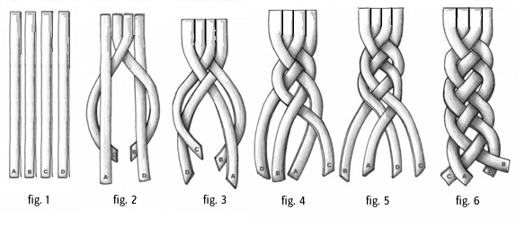
Simple
Composed of a single element; not compound
Complexify: to make complex
Complect: intertwine; interweave; to combine
Related software design principles
SOLID: Singular Responsibility Principle
SOLID: Interface segregation principle
Separation of Concerns
Don’t Repeat Yourself
Image from https://bagntell.files.wordpress.com/2012/02/four_string_braided-strap.jpg

Slide 4
Cohesion
High cohesion
Low cohesion
void MoveLeft (int units)
{
this.xPos -= units;
}
void DoUnrelatedStuff()
{
BuyMovieTickets();
MakeCoffee();
DriveToMuseum();
CashLotteryTicket();
}

Slide 5
Readable
Function of
Naming conventions
Formatting (white space)
Control flow (problem decomposition)
Reader’s experience with the language
See blockExample classes

Slide 6
Maintainable
Ease of the following tasks:
isolate defects or their cause,
correct defects or their cause,
repair or replace faulty or worn-out components without having to replace still working parts,
prevent unexpected breakdowns,
maximize a product's useful life,
maximize efficiency, reliability, and safety,
meet new requirements,
make future maintenance easier, or
cope with a changed environment.
We’ll come back to this with the Person*.cs examples

Slide 7
Coupling
Loose Coupling
Tight Coupling
IController controller;
controller = new KeyboardController();
controller.Update();
if(myGame.KeyboardController.
KeyA.isPushed)
{
Jump();
}

Slide 8
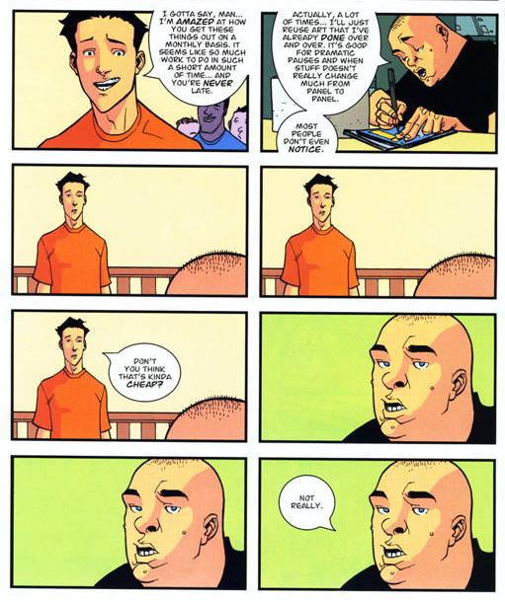
Reusable
Reuse of existing code in other projects
Related software design principle
Composition over inheritance
Identical Panel Gag image from http://tvtropes.org/pmwiki/pmwiki.php/ComicBook/Invincible

Slide 9
Two programming paradigms
Object-oriented Programming
Focus on readability
Objects are an abstraction to be used by client programmers, and should follow a mental model of the actual or imagined object it represents
Objects are “nouns” that have fields “adjectives” and methods “verbs”
More discussion on why OOP is useful here
Entity-Component System
Focus on reusability
Software should be constructed by gluing together prefabricated components like in electrical engineering
Functionality is attached to an object instead of inside its implementation

